Slide 1
Dr Kofi A. Ababio
BSc MSc MPhil PhD
kaababs@gmail.com_x000b_+233 24 4980077

Slide 2

Sampling Methods and
the Central Limit Theorem
Week 3: Part A

Slide 3
GOALS
Explain why a sample is the only feasible way to learn about a population.
Describe methods to select a sample.
Define and construct a sampling distribution of the sample mean.
Explain the central limit theorem.
Use the Central Limit Theorem to find probabilities of selecting possible sample means from a specified population.

Slide 4
Why Sample the Population?
The physical impossibility of checking all items in the population.
The cost of studying all the items in a population.
The sample results are usually adequate.
Contacting the whole population would often be time-consuming.
The destructive nature of certain tests.

Slide 5
Probability Sampling
A probability sample is a sample selected such that each item or person in the population being studied has a known likelihood of being included in the sample.

Slide 6
Methods of Probability Sampling
Simple Random Sample:
A sample formulated so that each item or person in the population has the same chance of being included.
Systematic Random Sampling:
The items or individuals of the population are arranged in some order. A random starting point is selected and then every kth member of the population is selected for the sample.

Slide 7
Methods of Probability Sampling
Stratified Random Sampling:
A population is first divided into subgroups, called strata, and a sample is selected from each stratum.
Cluster Sampling:
A population is first divided into primary units then samples are selected from the primary units.

Slide 8
Methods of Probability Sampling
In nonprobability sample inclusion in the sample is based on the judgment of the person selecting the sample.
The sampling error is the difference between a sample statistic and its corresponding population parameter.

Slide 9
Sampling Distribution of the Sample Means
The sampling distribution of the sample mean is a probability distribution consisting of all possible sample means of a given sample size selected from a population.

Slide 10
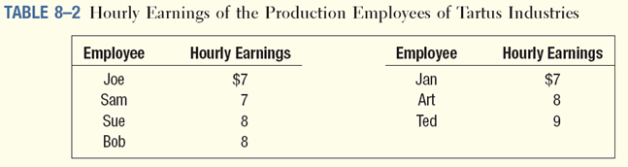
Sampling Distribution of the Sample Means - Example
Tartus Industries has seven production employees (considered the population). The hourly earnings of each employee are given in the table below.
1. What is the population mean?
2. What is the sampling distribution of the sample mean for samples of size 2?
3. What is the mean of the sampling distribution?
4. What observations can be made about the population and the sampling distribution?

Slide 11
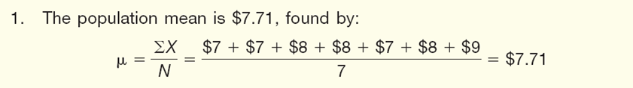
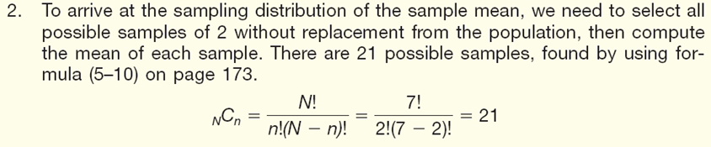
Sampling Distribution of the Sample Means - Example

Slide 12
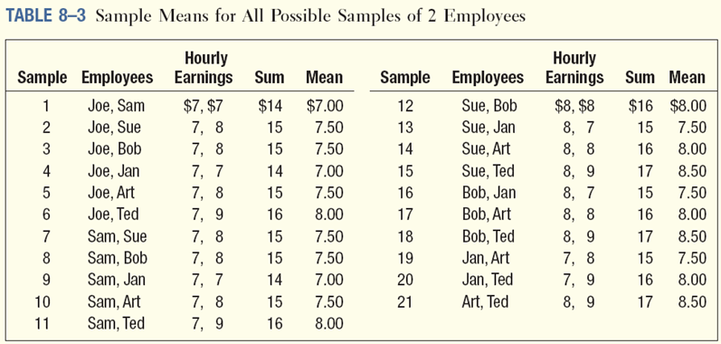
Sampling Distribution of the Sample Means - Example

Slide 13
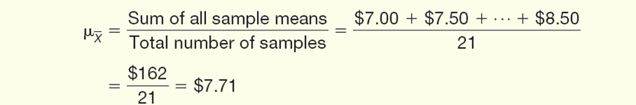
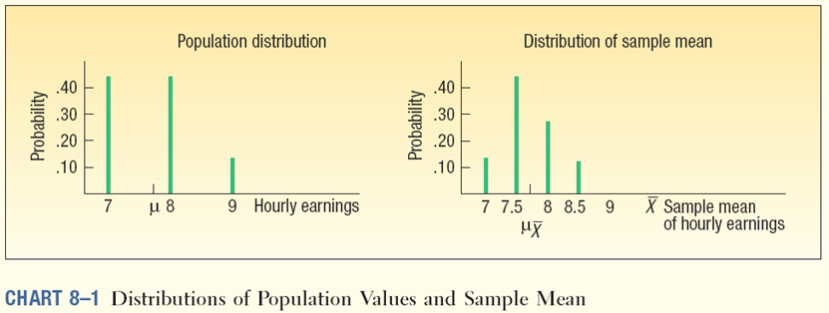
Sampling Distribution of the Sample Means - Example

Slide 14
Central Limit Theorem
For a population with a mean μ and a variance σ² the sampling distribution of the means of all possible samples of size n generated from the population will be approximately normally distributed.
The mean of the sampling distribution equal to μ and the variance equal to σ²/n.

Slide 15
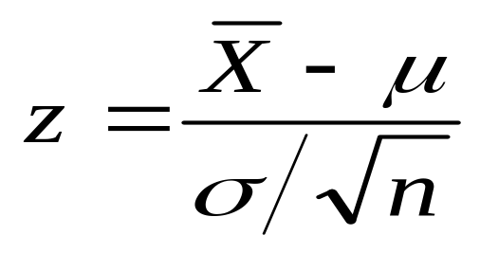
Using the Sampling
Distribution of the Sample Mean (Sigma Known)
If a population follows the normal distribution, the sampling distribution of the sample mean will also follow the normal distribution.
To determine the probability a sample mean falls within a particular region, use:

Slide 16
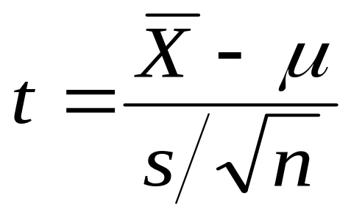
Using the Sampling
Distribution of the Sample Mean (Sigma Unknown)
If the population does not follow the normal distribution, but the sample is of at least 30 observations, the sample means will follow the normal distribution.
To determine the probability a sample mean falls within a particular region, use:

Slide 17
Using the Sampling Distribution of the Sample Mean (Sigma Known) - Example
The Quality Assurance Department for Cola, Inc., maintains records regarding the amount of cola in its Jumbo bottle. The actual amount of cola in each bottle is critical, but varies a small amount from one bottle to the next. Cola, Inc., does not wish to under fill the bottles. On the other hand, it cannot overfill each bottle. Its records indicate that the amount of cola follows the normal probability distribution. The mean amount per bottle is 31.2 ounces and the population standard deviation is 0.4 ounces. At 8 A.M. today the quality technician randomly selected 16 bottles from the filling line. The mean amount of cola contained in the bottles is 31.38 ounces.
Is this an unlikely result? Is it likely the process is putting too much soda in the bottles? To put it another way, is the sampling error of 0.18 ounces unusual?

Slide 18
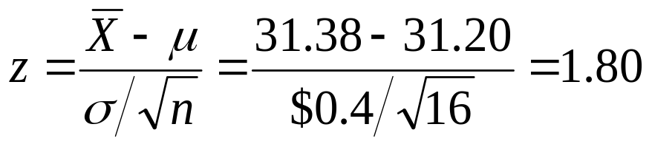
Using the Sampling Distribution of the Sample Mean (Sigma Known) - Example
Step 1:
Find the z-values corresponding to the sample mean of 31.38

Slide 19
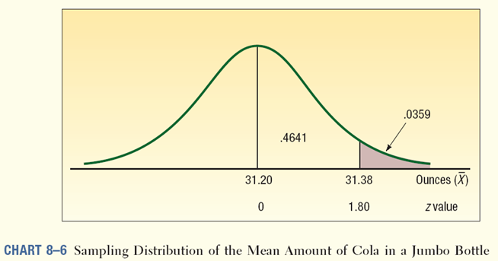
Using the Sampling Distribution of the Sample Mean (Sigma Known) - Example
Step 2:
Find the probability of observing a Z equal to or greater than 1.80

Slide 20
Using the Sampling Distribution of the Sample Mean (Sigma Known) - Example
What do we conclude?
It is unlikely, less than a 4 percent chance, we could select a sample of 16 observations from a normal population with a mean of 31.2 ounces and a population standard deviation of 0.4 ounces and find the sample mean equal to or greater than 31.38 ounces.
We conclude the process is putting too much cola in the bottles.

Slide 21
End of Week 3: Part A

Slide 22

Estimation and Confidence Intervals
Week 3: Part B

Slide 23
GOALS
Define a point estimate.
Define level of confidence.
Construct a confidence interval for the population mean when the population standard deviation is known.
Construct a confidence interval for a population mean when the population standard deviation is unknown.
Construct a confidence interval for a population proportion.

Slide 24
Point and Interval Estimates
A point estimate is the statistic, computed from sample information, which is used to estimate the population parameter.
A confidence interval estimate is a range of values constructed from sample data so that the population parameter is likely to occur within that range at a specified probability. The specified probability is called the level of confidence.

Slide 25
Factors Affecting Confidence Interval Estimates
The factors that determine the width of a confidence interval are:
    1. The sample size, n.
    2. The variability in the population, usually σ estimated by s.
    3. The desired level of confidence.

Slide 26
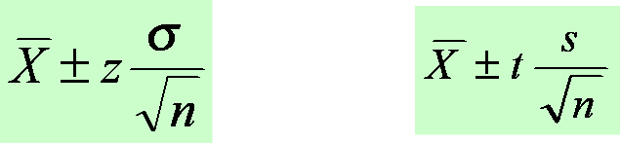
Confidence Interval Estimates for the Mean
Use Z-distribution
If the population standard deviation is known or the sample is greater than 30.
Use t-distribution
If the population standard deviation is unknown and the sample is less than 30.

Slide 27
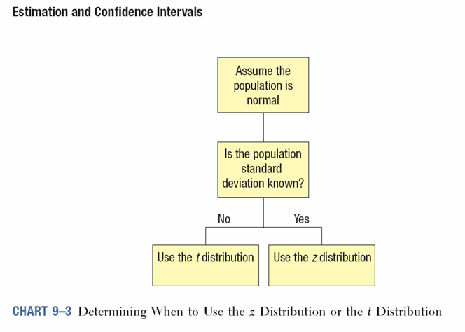
When to Use the z or t Distribution for Confidence Interval Computation

Slide 28
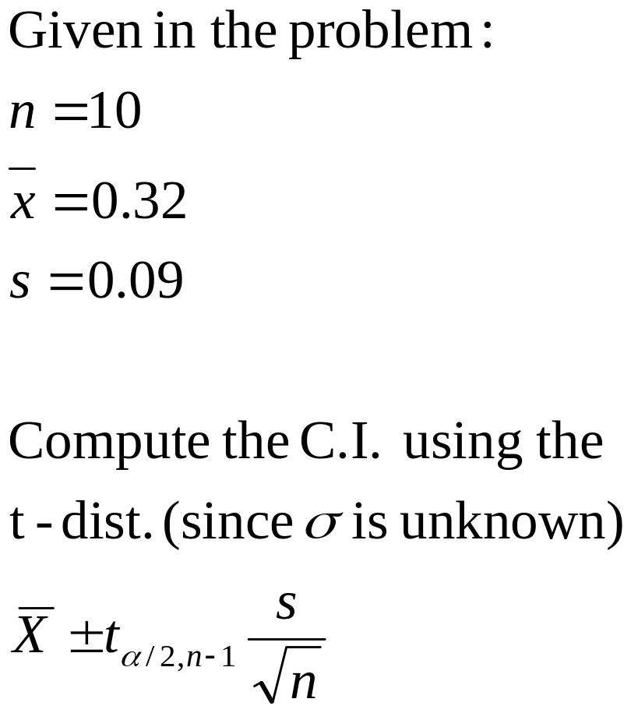
Confidence Interval for the Mean – Example using the t-distribution
A tire manufacturer wishes to investigate the tread life of its tires. A sample of 10 tires driven 50,000 miles revealed a sample mean of 0.32 inch of tread remaining with a standard deviation of 0.09 inch.
Construct a 95 percent confidence interval for the population mean. Would it be reasonable for the manufacturer to conclude that after 50,000 miles the population mean amount of tread remaining is 0.30 inches?

Slide 29
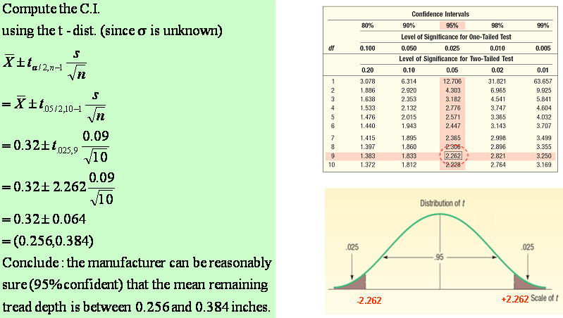
Student’s t-distribution Table

Slide 30


Confidence Interval Estimates for the Mean:
An example
The manager of the Inlet Square Mall, near Ft. Myers, Florida, wants to estimate the mean amount spent per shopping visit by customers. A sample of 20 customers reveals the following amounts spent. Construct a 95% CI?

Slide 31
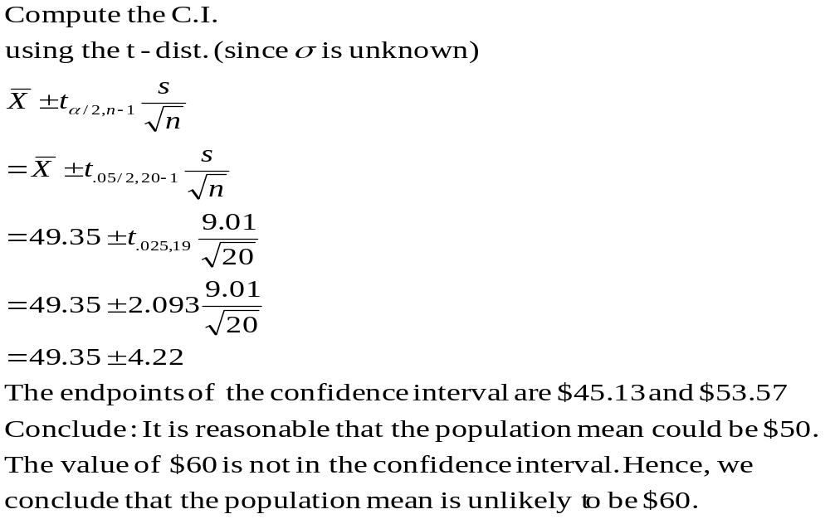
Confidence Interval Estimates for the Mean – By Formula

Slide 32
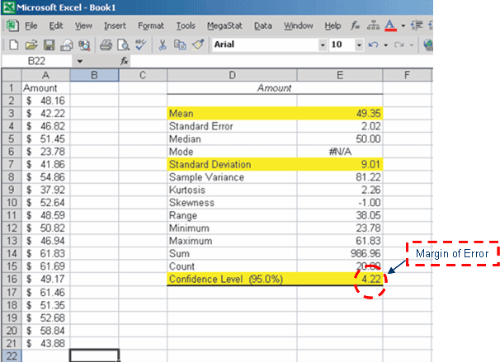
Confidence Interval Estimates for the Mean – Using Excel

Slide 33
Confidence Interval for a Proportion
To develop a confidence interval for a proportion, we need to meet the following assumptions.
1. The binomial conditions, discussed in Chapter 6, have been met. Briefly, these conditions are:
a. The sample data is the result of counts.
b. There are only two possible outcomes.
c. The probability of a success remains the same from one trial to the next.
d. The trials are independent. This means the outcome on one trial does not affect the outcome on another.
2. The values n π and n(1-π) should both be greater than or equal to 5. This condition allows us to invoke the central limit theorem and employ the standard normal distribution, that is, z, to complete a confidence interval.

Slide 34
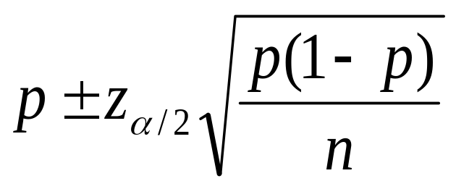
Confidence Interval for a Population Proportion
The confidence interval for a population proportion is estimated by:

Slide 35
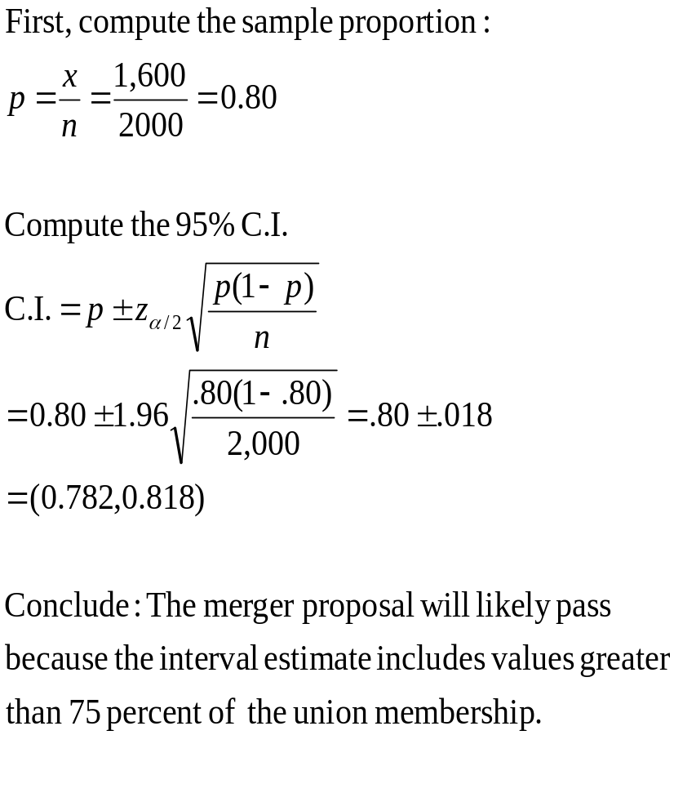
Confidence Interval for a Population Proportion- Example
The union representing the Bottle Blowers of America (BBA) is considering a proposal to merge with the Teamsters Union. According to BBA union bylaws, at least three-fourths of the union membership must approve any merger. A random sample of 2,000 current BBA members reveals 1,600 plan to vote for the merger proposal. What is the estimate of the population proportion?
Develop a 95 percent confidence interval for the population proportion. Basing your decision on this sample information, can you conclude that the necessary proportion of BBA members favor the merger? Why?

Slide 36
End of Week 3: Part B

